Slide 1
Ready, Set, Test: Tips on Preparing for the AAMC PREviewTM Exam
Lisa Peters, Director, Test Operations
Thomas Geiger, Manager, PREview Content Development
March 28, 2023

Slide 2
What We’ll Cover
An Introduction to the PREview Exam
Preparing for the Exam
Learn the Structure and Format of the Exam
Using PREview Preparation Resources
Preparing for Test Day
Accessing Available Resources
Q&A

Slide 3
An Introduction to the PREview Exam
Medical School Focused
Uses scenarios that students may encounter in medical school.
Convenient
You complete the exam at a location of your choosing.
Showcase Your Knowledge
The AAMC PREview exam is an opportunity for you to showcase your knowledge of competencies that go beyond your academic readiness.
Scores are incorporated in your AMCAS application.
The exam takes approximately 75 minutes to complete.
Developed in collaboration with educators throughout the medical school community.

Slide 4
Understanding the Exam’s Design

Slide 5
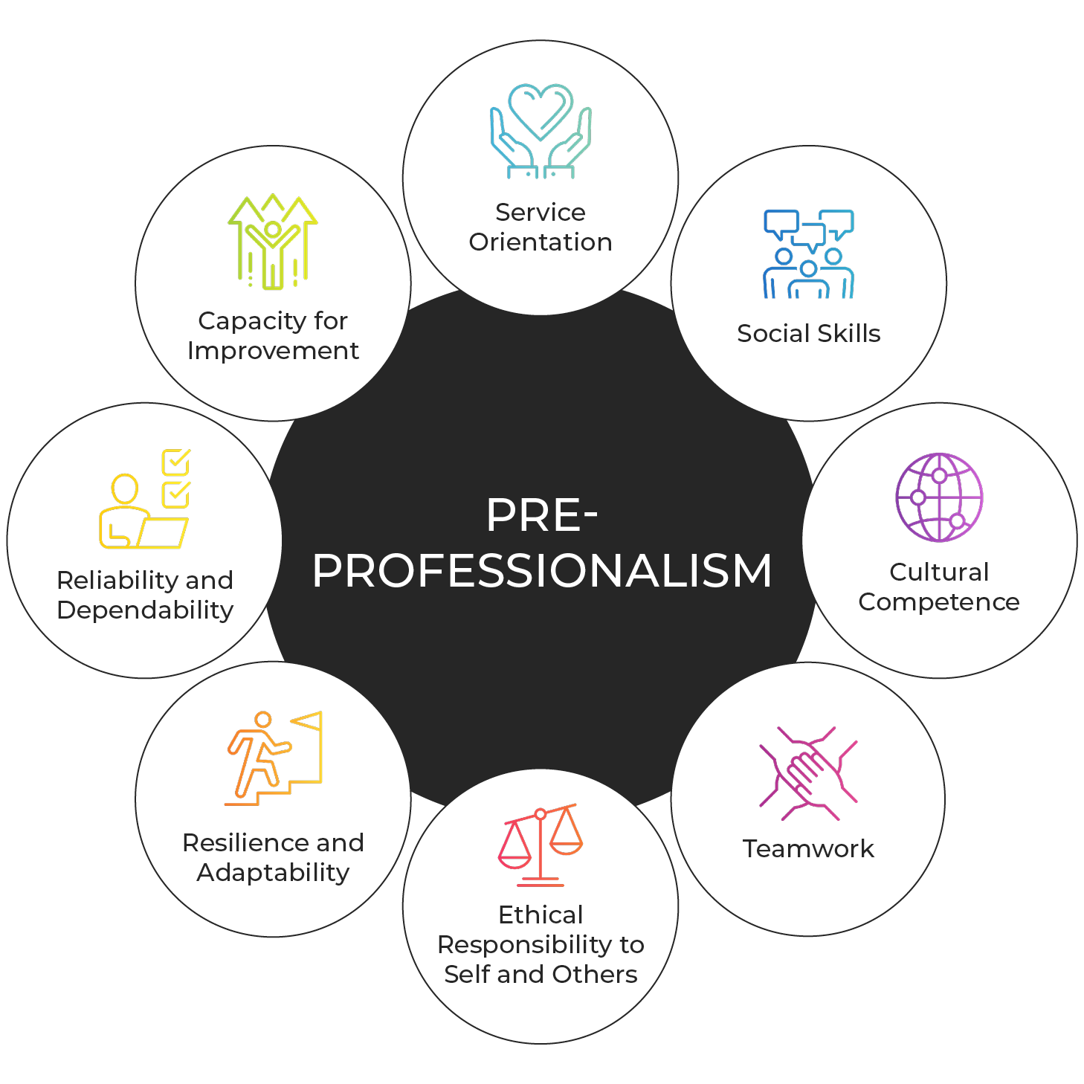
Know the Competencies Measured on the Exam
Service Orientation
Social Skills
Cultural Competence
Teamwork
Ethical Responsibility to Self and Others
Reliability and Dependability
Resilience and Adaptability
Capacity for Improvement

Slide 6
Understand How the Competencies Are Assessed on the Exam
Scenario
While viewing a classmate’s social media profile, you notice that your classmate has made negative comments about treating a recent patient. Your classmate describes the patient and the patient’s condition in detail, which violates patient privacy regulations.
Please rate the effectiveness of each response to this situation.
Responses
Explain to your classmate the importance of patient privacy and ask them to remove the comments.
Report your classmate’s behavior as a privacy violation.
Read through your classmate's previous comments to see how often they comment about patients.
Avoid reading your classmate’s social media profile in the future.
Suggest your classmate remove the comments as soon as possible.
Very Ineffective | Ineffective | Effective | Very Effective

Slide 7
Understand How to Evaluate Responses
Each response should be:
Considered an immediate next step unless otherwise specified
Rated independently
Do not compare responses to each other
Do not rank order responses
Do not combine responses when considering your rating
Each rating can be used more than once or not at all
Each scenario includes a sample of possible responses

Slide 8
Preparing for the Exam

Slide 9
Examinee Preparation Guide
Provides preparation advice and strategies for completing the PREview exam
Overview of test format
Instructions for examinees
Guidance on how to evaluate responses

Slide 10
Read the Full Definitions of the Core Competencies

Slide 11
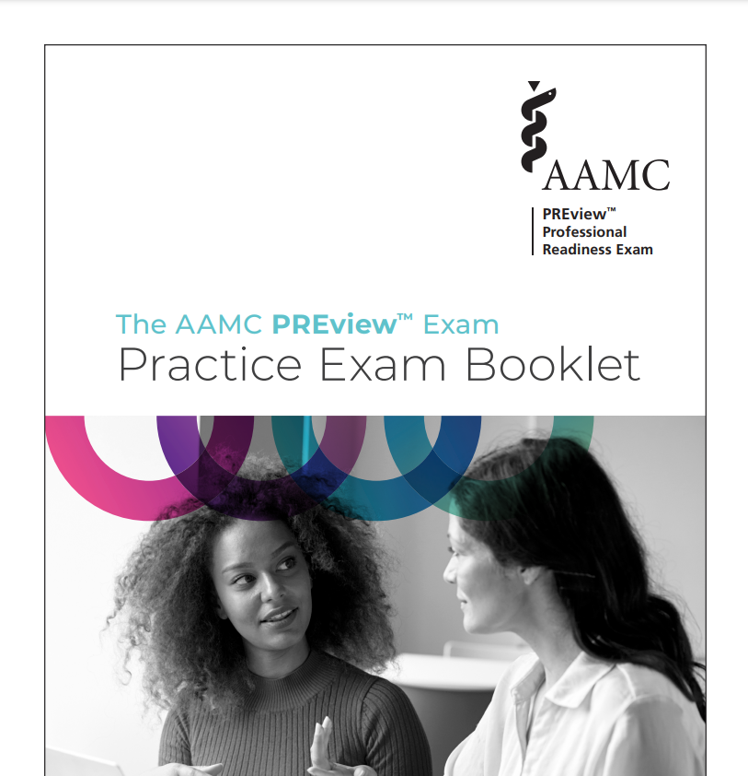
Practice with the Free AAMC PREview™ Exam Practice Exam Booklet
Full-Length Exam
Scoring Key
Answer Rationales

Slide 12
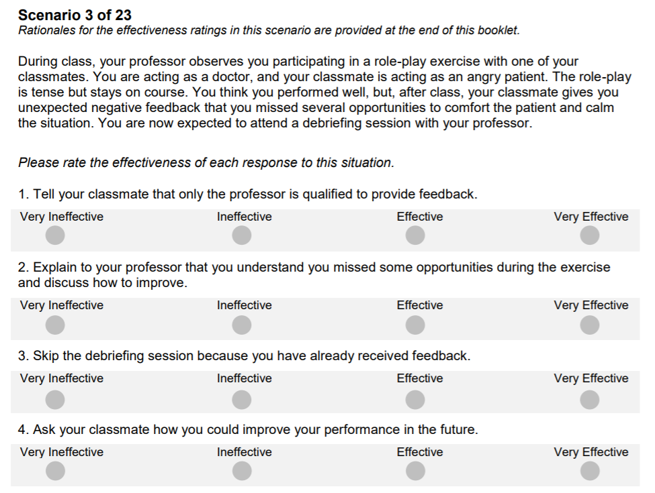
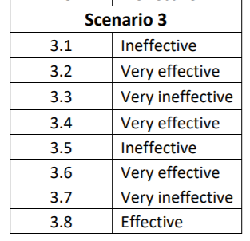

Slide 13
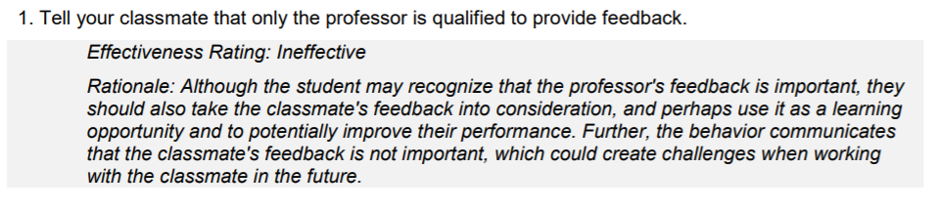

Slide 14
Preparing for Test Day

Slide 15
Get Ready to Test
Step 1
Step 2
Step 3
Step 4
Confirm you meet the basic requirements
Test your Computer
Get to know the testing platform
Get familiar with remote testing

Slide 16
Confirm You Meet the Basic Requirements
Technical
Microphone
Workspace
Private room
I.D.
Government-Issued
Video Camera
Browser
ProctorU Extension
Well-lit
Clear space
Single monitor
Signature
Photo
Expiration Date

Slide 17
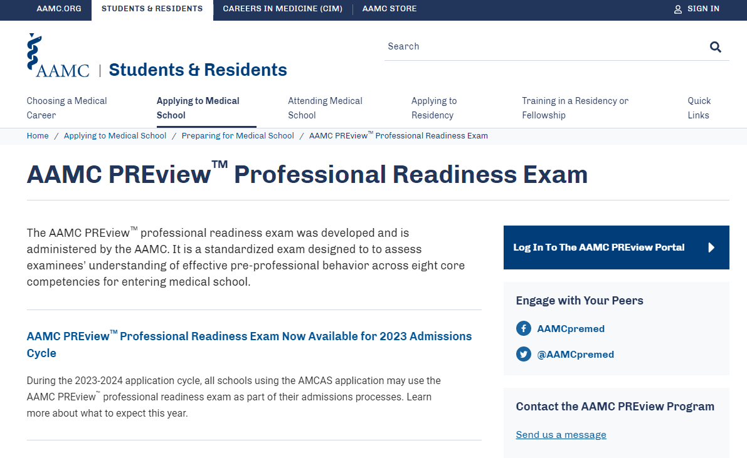
Access the PREview Portal

Slide 18
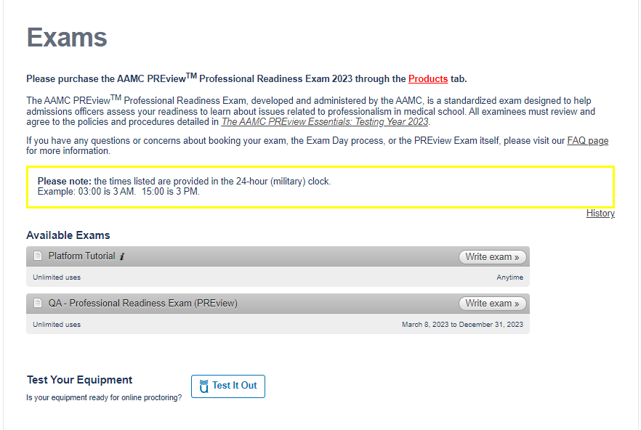
Test Your Equipment

Slide 19
Become Familiar with the Testing Platform

Slide 20
Become Familiar with Remote Proctoring
This video is designed to help you become familiar with the activities that will take place when logging into and taking the AAMC PREview exam
Check-in
Remote Proctoring
Exam Platform
Testing
Submission
Check-out

Slide 21
Accessing Available Resources

Slide 22
Access Free AAMC Preparation Resources
To help you prepare for the exam
Examinee Preparation Guide
To help you prepare for test day
AAMC PREview Essentials
Exam Sample
Test Day Experience Video
Online Testing System Tutorial
PREview™ Nuts-n-Bolts: Scheduling and Taking the AAMC PREview™ Professional Readiness Exam Webinar
Practice Exam Booklet

Slide 23
>80% of Applicants Will be Asked to take the Exam
Required
Recommended
SJT Required
Research Only
9
11
2
16
Numbers reflect participating schools as of 3/21. Additional schools may decide to participate through April.

Slide 24
Required (more schools may be added)
Carle Illinois College of Medicine
Mercer University School of Medicine
Saint Louis University School of Medicine
Universidad Central del Caribe School of Medicine
University of California, Davis, School of Medicine
University of California, Los Angeles David Geffen School of Medicine
University of Hawaii, John A. Burns School of Medicine
University of Massachusetts T.H. Chan School of Medicine
University of Utah School of Medicine

Slide 25
Recommended (more schools may be added)
Chicago Medical School at Rosalind Franklin University of Medicine & Science
Cooper Medical School of Rowan University
Des Moines University Medicine & Health Sciences
Geisinger Commonwealth School of Medicine
George Washington University School of Medicine and Health Sciences
Louisiana State University School of Medicine in New Orleans
Morehouse School of Medicine
Oakland University William Beaumont School of Medicine
Southern Illinois University School of Medicine
University of Alabama at Birmingham Marnix E. Heersink School of Medicine
University of Louisville School of Medicine

Slide 26
SJT Required; PREview Exam Satisfies (more schools may be added)
Michigan State University College of Human Medicine
Rutgers, Robert Wood Johnson Medical School

Slide 27
Notes:
You can access the PREview website and all of our contact information from this QR code.

Slide 28
Q & A
Notes:
We have some time for questions so let’s see if some have come in.

