Slide 1
PREview™ Nuts-n-Bolts: Scheduling and Taking the AAMC PREview™ Professional Readiness Exam
Michelle Sparacino, Director, Test Administration
February 28, 2023

Slide 2
What We’ll Cover
Understanding the Exam
Participating Schools
Registering and Preparing for the Exam
Taking the Exam: What to Expect on Test Day
Receiving and Understanding Your Scores
Q&A

Slide 3
Understanding the Exam

Slide 5
Schools require or recommend the PREview exam to signal that these competencies are integral to medical education.
Submitting PREview scores with your application conveys to medical schools that you understand these foundational competencies are critical to success.

Slide 6
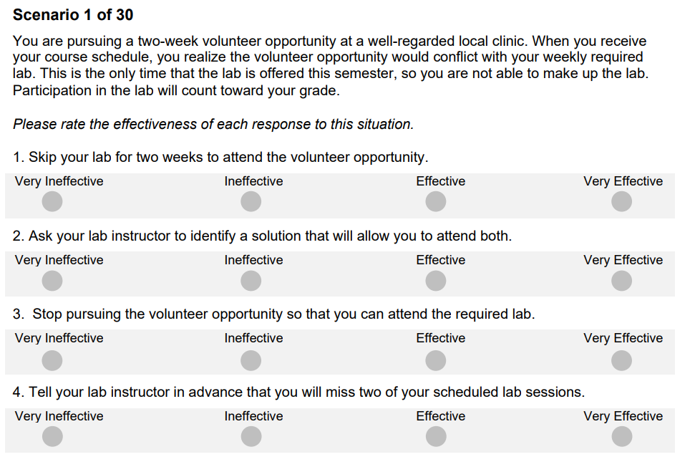
Scenarios Present a Conflict or Dilemma You Must Rate
30 scenarios
186 responses
75 minutes (standard time)

Slide 7
Schools Use Scores As One Part of Holistic Review
Personal Statement
Letters of Recomm-endation
Experiences
Interview
(traditional, MMI)
Other school- specific assess-ments
AAMC PREview scores
Considered alongside other application information
Viewed as a “plus factor” or opportunity to strengthen the application
Given low weight relatively to other pieces of the application
7

Slide 8
Participating Schools

Slide 9
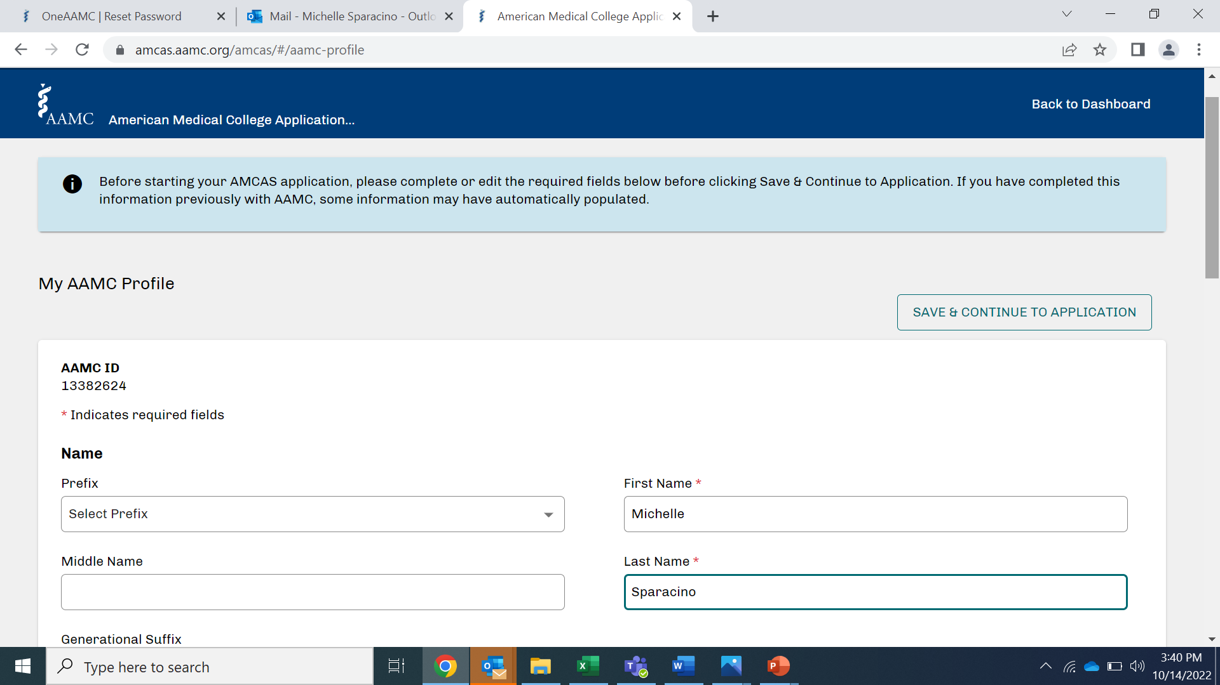
Open to All AMCAS Schools in 2023

Slide 10
Schools Have a Few More Weeks to Indicate Their Participation
Cooper Medical School of Rowan University
Des Moines University Medicine & Health Sciences
George Washington University School of Medicine and Health Sciences
Mercer University School of Medicine
Michigan State University College of Human Medicine
Morehouse School of Medicine
Oakland University William Beaumont School of Medicine
Rutgers, Robert Wood Johnson Medical School
Saint Louis University School of Medicine
University of Alabama at Birmingham Marnix E. Heersink School of Medicine
University of California, Davis, School of Medicine
University of California, Los Angeles David Geffen School of Medicine
University of Louisville School of Medicine
University of Massachusetts T.H. Chan School of Medicine
University of Utah School of Medicine
Partial list!
More schools will confirm through
April

Slide 11
Registering and Preparing for the Exam

Slide 12
Registration Is Open for All Exam Dates
Window | Exam Dates | Registration Close | Score Release
1 | March 16 & 17 | March 2 | April 18
2 | May 10 & 11 | April 26 | June 13
3 | June 14 & 15 | June 1 | July 18
4 | July 12 & 13 | June 28 | August 15
5 | August 16 & 17 | August 2 | September 19
6 | September 13 & 14 | August 30 | October 17
7 | October 11 & 12 | September 27 | November 9
PREview Registration Fees
Standard Flat Fee: $100
Fee Assistance Program: $0
One assessment. One fee.
No matter how many schools.
Visit www.aamc.org/preview to learn more and register for the PREview exam.

Slide 13
Choose your test day
Determine if you need to apply for accommodations
Identify a work space that meets AAMC requirements
Ensure your computer meets the technical requirements
Test your computer
Get to know the testing platform

Slide 14
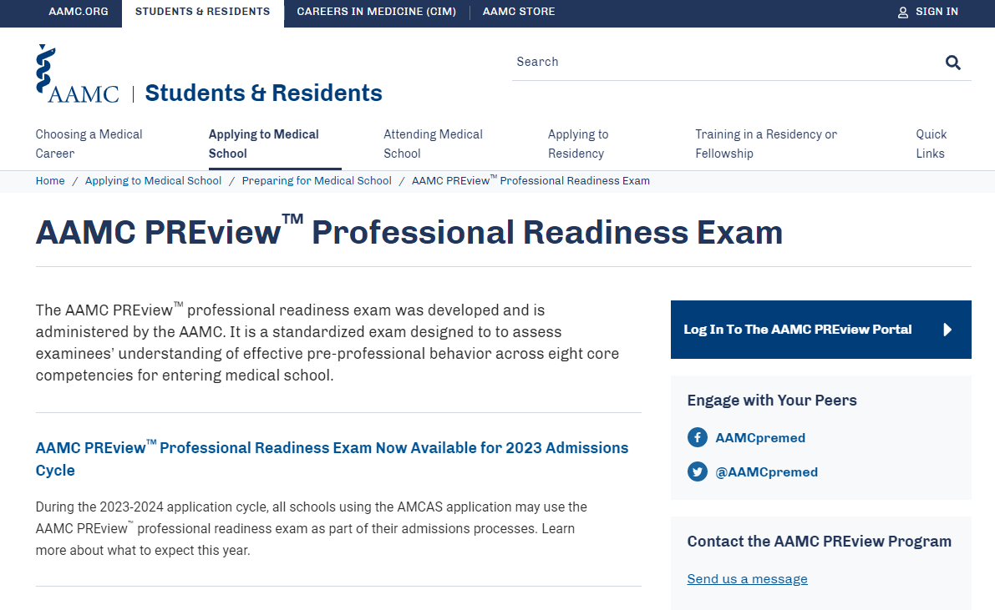
All Exam Activity Occurs in the Exam Portal

Slide 15
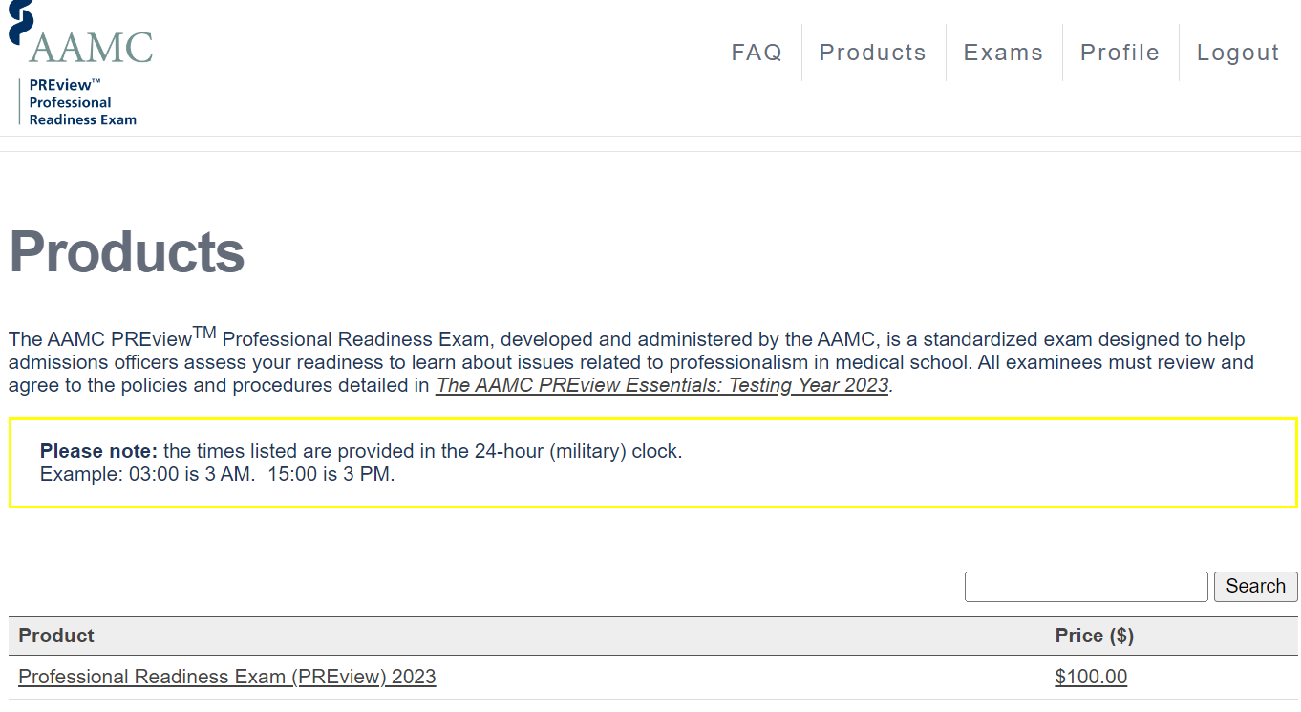
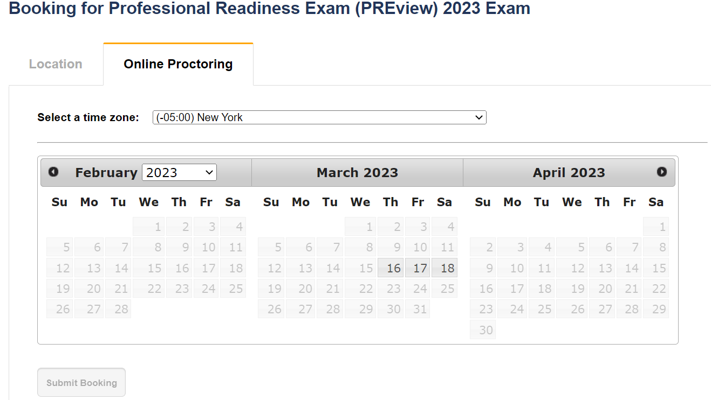
All Exam Activity Occurs in the Exam Portal

Slide 16
Note the Appointment Time and Time Zone
The exam will be delivered each test date from 8 a.m. to 1 a.m. Eastern time.
Your appointment will be in the time zone you select when scheduling your appointment
Appointments will be displayed in local military time (24-hour clock) within the examinee portal. For example, 08:00 is 8 AM, and 20:00 is 8 PM.

Slide 17
Reschedule by the Deadline
Scheduling and rescheduling deadlines are the same
$25 fee (free for FAP approved examinees)
Reschedule after the deadline only for approved emergencies
Window | Exam Dates | Registration Close
1 | March 16 & 17 | March 2
2 | May 10 & 11 | April 26
3 | June 14 & 15 | June 1
4 | July 12 & 13 | June 28
5 | August 16 & 17 | August 2
6 | September 13 & 14 | August 30
7 | October 11 & 12 | September 27

Slide 18
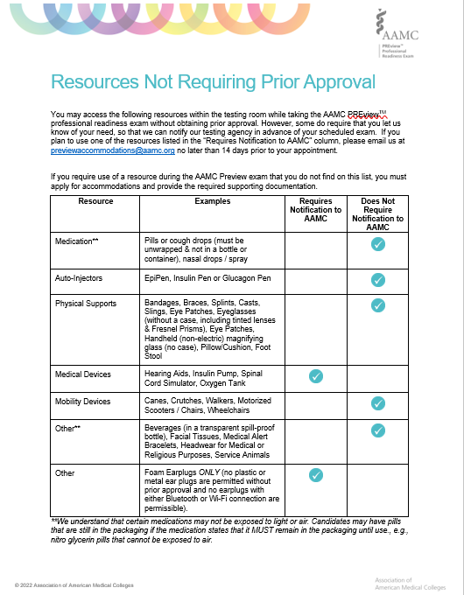
Some Resources Require Prior Notification But Not an Application
Notification should be sent to:
Previewaccommodations@aamc.org
No later than two (2) weeks prior to the testing window.

Slide 19
Some Accommodations Require Prior Approval
Review Testing Conditions
Consult “Resources Not Requiring Prior Approval
Consider Application Cycles and Important Dates
Review Documentation Requirements
Submit Application and Supporting Documentation

Slide 20
Follow AAMC Tips for a Smoother Application Process
Apply Early!
Review timeframes are 30 – 60 days
Review the Documentation Guidelines carefully
If you have multiple conditions, review the guidelines for each.
Ensure your documentation is current
Review the currency requirements for the condition(s) for which
Contact the PREview Accommodations team with any questions
Share the guidelines with a qualified professional
you are applying
Applications that arrive incomplete often take longer

Slide 21
Follow AAMC Tips for a Smoother Application Process (Cont’d)
Submit all required documentation
AAMC requires more than just a recent evaluation – ensure
Get personal with the Personal Statement
Do not just reiterate the information in the professionals’ evaluation
Remember the PREview and MCAT applications are separate
Submit a PREview application even if the MCAT application is already
application includes everything listed in the requirements
Augment the evaluation with real life experience, examples, and how the condition affects you
submitted or MCAT determination received

Slide 22
Access Free AAMC Preparation Resources
To help you understand policies and procedures
AAMC PREview Essentials
To help you practice for the exam scenarios
Practice Exam Booklet
Test Day Experience Video
PREview website
Online Testing System Tutorial
Examinee Preparation Guide

Slide 23
Attend the AAMC Virtual Medical School Fair
April 28 – 29, 2023
Registration is now open:
https://aamcmedschoolfair.vfairs.com/en/

Slide 24
Taking the Exam

Slide 25
Test Day Activities
AAMC Professional Readiness Exam Overview
Section | Time
Check-In | 5-10 minutes
Examinee Agreement and Exam Instructions | 5-10 minutes
Exam Time | 75 minutes
Void Question and School Selection | 5 minutes
Total Exam Time | 75 minutes (1 hour and 15 minutes)
Total Session Time | 90-100 minutes
Post- Exam Survey (optional) | 5 minutes
Arrive 15 min early to ensure you will be ready to start on time.

Slide 26
Confirm You Meet the Basic Requirements
Technical
Microphone
Workspace
Private room
I.D.
Government-Issued
Video Camera
Browser
ProctorU Extension
Well-lit
Clear space
Single monitor
Signature
Photo
Expiration Date

Slide 27
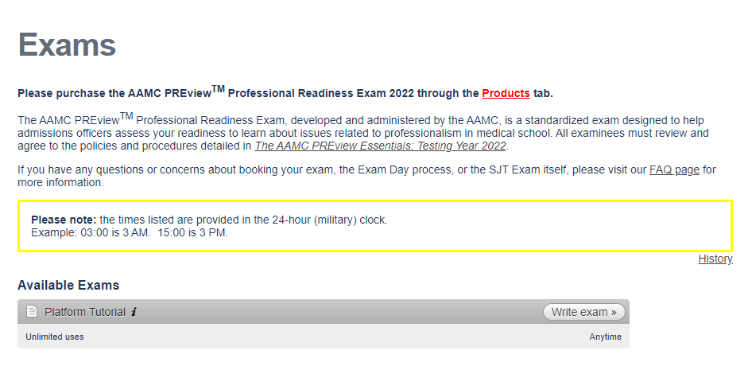
Become Familiar with the Testing Platform

Slide 28
Become Familiar with Remote Proctoring
This video is designed to help you become familiar with the activities that will take place when logging into and taking the AAMC PREview exam
Check-in
Remote Proctoring
Exam Platform
Testing
Submission
Check-out

Slide 29
Receiving and Understanding Your Scores

Slide 30
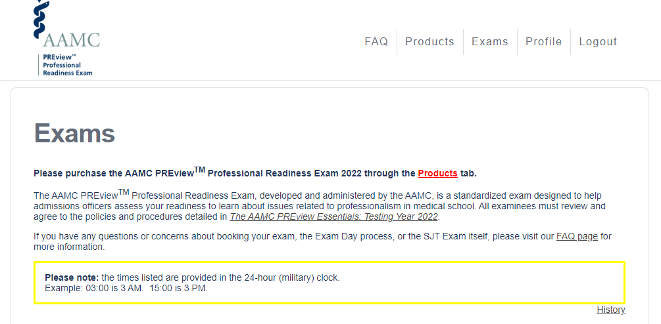
See Your Scores ~30 Days After Testing

Slide 31
Your Score Report Includes Three Key Pieces of Information:
Total Score
Confidence Band
Percentile Rank

Slide 32
Examinees Receive the Same Information As Schools
At the same time scores are released to you, they are also released to AMCAS
Your score is also sent to any participating non-AMCAS schools that you selected on test day.
Your advisor can see your scores with your consent

Slide 33
The PREview Team Is Here to Support You
The AAMC and our testing vendor are prepared to support you through every phase of the PREview Testing Season.
Contact Us for:
General Questions about the AAMC PREview Exam
Technical Questions about the AAMC PREview Portal
Support During the AAMC PREview Exam
Accommodations for the AAMC PREview Exam

Slide 35
Q & A

