Slide 1
What’s New with the PREview™ Exam: Preparing Your Students for the 2023 Administration
Michelle Sparacino, Director, Test Administration
February 23, 2023

Slide 2
Agenda
Enhancing the Exam Experience for 2023
Understanding the Exam’s Purpose
2023 Participating Medical Schools
Testing in 2023
Applying for Accommodations
Preparing for the Exam
Connecting with the PREview Team and Learning More

Slide 3
Enhancing the Exam for 2023: What’s New for the PREview™ Exam
Earlier score reporting is needed to facilitate use of PREview scores earlier in the admissions process and advising
First exam window will be administered in March 2023
Pre-health advisors have requested access to PREview scores to assist in advising
Scores will be released (with examinee permission), to the
AAMC Advisor Information System (AIS)
Remote online testing is not viable for the delivery of certain accommodations
Scantron centers will be utilized to deliver in-person testing for specific examinees
Some applicants unaware of school participation
Participating school information added to AMCAS; future exam date added to AMCAS

Slide 4
Understanding the Exam’s Purpose

Slide 5
Measures Potential to Develop Professional Competencies

Slide 6
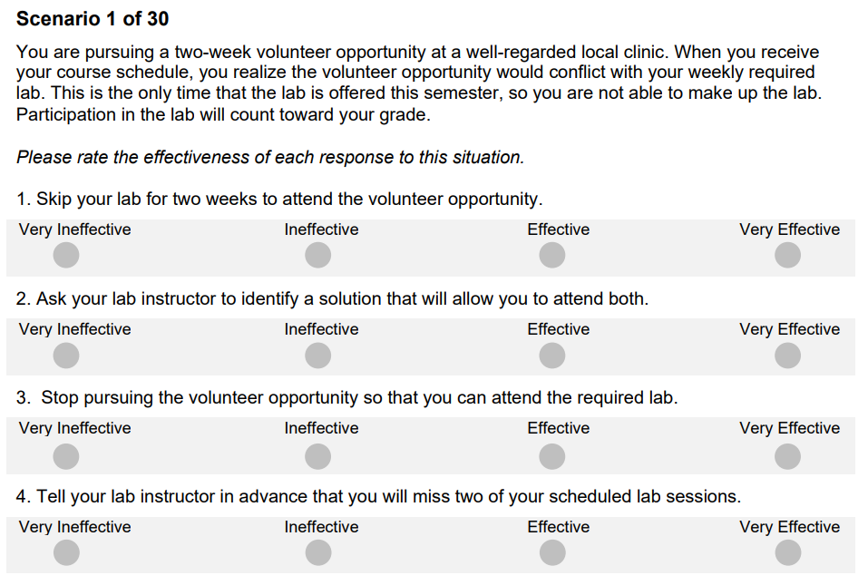
Scenarios Present a Conflict or Dilemma
30 scenarios
186 responses
75 minutes (standard time)

Slide 7
Scores Reflect Alignment with Medical Educators’ Ratings
Scoring Key Development
Medical educators rate the effectiveness of each response
Key reflects the effectiveness rating agreed upon by medical educators
Scoring Examinees
Full credit = examinee’s rating matches medical educators’ rating
Partial credit = examinee’s rating is close to the medical educators’ rating
PREview Total Scores
Scale score = 1-9
Reflect the extent to which examinees’ effectiveness ratings align with medical educators’ ratings

Slide 8
Score Reports Provide Important Context for Examinees and Schools:
Total Score
Confidence Band
Percentile Rank

Slide 9
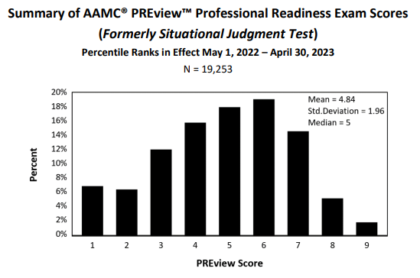
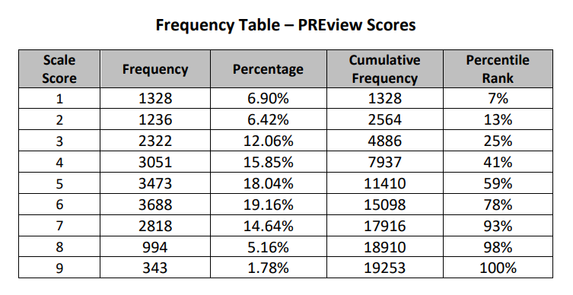
Mean Scores Have Increased Slightly
9

Slide 10
Scores will be released to the Advisor Information System (AIS)
Examinees will consent on exam day prior to starting the exam
First release to the AIS by June, if not earlier
Includes same score information provided to students and schools

Slide 11
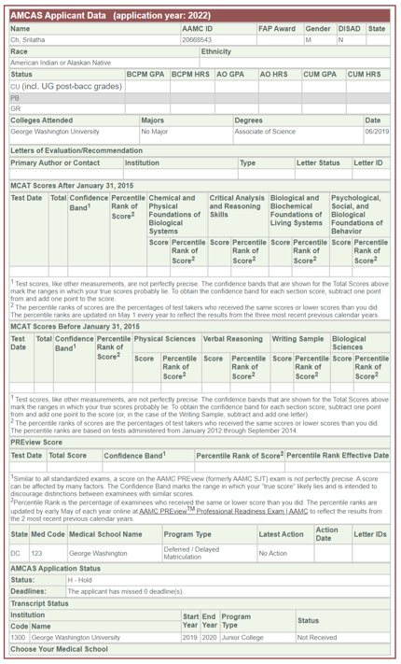
Access PREview scores via:
Quick Lookup
Roster of Applicants
PREview Roster
Designated Schools

Slide 12
Schools Use Scores As One Part of Holistic Review
Personal Statement
Letters of Recommendation
Experiences
Interview
(traditional, MMI)
Other school- specific assessments
AAMC PREview scores
Considered alongside other application information
Viewed as a “plus factor” or opportunity to strengthen the application
Given low weight relatively to other pieces of the application

Slide 13
Schools Use Scores at Different Stages of Review
Pre-screening, as a complement to academic metrics (MCAT, GPA)
Select applicants for interview, alongside other application information
Make final admissions decisions, alongside application information and interview scores

Slide 14
2023 Participating Schools

Slide 15
Now Open to All AMCAS Schools
+
2021
6 Schools
2023
25 – 30 Expected
2022
18 Schools
2020
2 AMCAS schools

Slide 16
Some New Schools Have Already Committed
Cooper Medical School of Rowan University
Des Moines University Medicine & Health Sciences
George Washington University School of Medicine and Health Sciences
Mercer University School of Medicine
Michigan State University College of Human Medicine
Morehouse School of Medicine
Oakland University William Beaumont School of Medicine
Rutgers, Robert Wood Johnson Medical School
Saint Louis University School of Medicine
University of Alabama at Birmingham Marnix E. Heersink School of Medicine
University of California, Davis, School of Medicine
University of California, Los Angeles David Geffen School of Medicine
University of Louisville School of Medicine
University of Massachusetts T.H. Chan School of Medicine
University of Utah School of Medicine
Partial list!
More schools will confirm through
April

Slide 17
Testing in 2023

Slide 18
Testing and Delivering Scores Earlier
Window | Exam Dates | Score Release
1 | March 16 & 17 | April 18
2 | May 10 & 11 | June 13
3 | June 14 & 15 | July 18
4 | July 12 & 13 | August 15
5 | August 16 & 17 | September 19
6 | September 13 & 14 | October 17
7 | October 11 & 12 | November 9
Registration opened January 17
Scores available to schools when AMCAS opens.
Accommodations application open year-round
Registration fee is $100, for unlimited score release
Registration free for FAP-approved examinees.

Slide 19
Applying for Accommodations

Slide 20
Extra Time and Breaks Are the Most Frequently Requested Accommodations
Review Testing Conditions
Consult “Resources Not Requiring Prior Approval
Consider Application Cycles and Important Dates
Review Documentation Requirements
Submit Application and Supporting Documentation

Slide 21
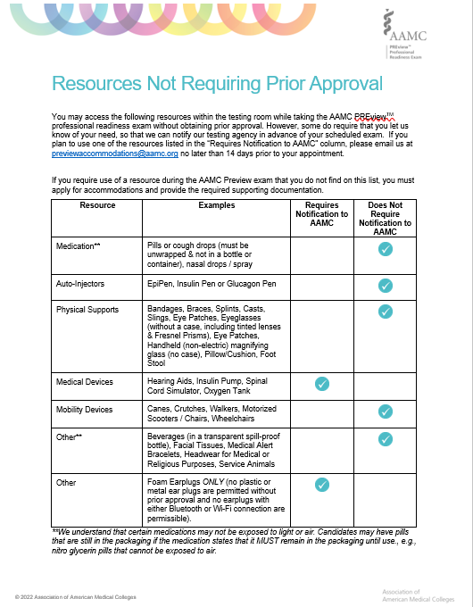
Some Resources Require Prior Notification But Not an Application
Notification should be sent to:
Previewaccommodations@aamc.org
No later than two (2) weeks prior to the testing window.

Slide 22
Follow AAMC Tips for a Smoother Application Process
Apply Early!
Review timeframes are 30 – 60 days
Review the Documentation Guidelines carefully
If you have multiple conditions, review the guidelines for each.
Ensure your documentation is current
Review the currency requirements for the condition(s) for which
Contact the PREview Accommodations team with any questions
Share the guidelines with a qualified professional
you are applying
Applications that arrive incomplete often take longer

Slide 23
Follow AAMC Tips for a Smoother Application Process (Cont’d)
Submit all required documentation
AAMC requires more than just a recent evaluation – ensure
Get personal with the Personal Statement
Do not just reiterate the information in the professionals’ evaluation
Remember the PREview and MCAT applications are separate
Submit a PREview application even if the MCAT application is already
application includes everything listed in the requirements
Augment the evaluation with real life experience, examples, and how the condition affects you
submitted or MCAT determination received

Slide 24
PREview Accommodations Should Not Feel Like a Mystery
Contact the PREview accommodations team for support:
previewaccommodations@aamc.org

Slide 25
Preparing for the PREview Exam

Slide 26
Testing Session is Approximately 1 ½ Hours
AAMC PREview Exam Session Overview
Section | Time
Check-In | 5-15 minutes
Examinee Agreement and Exam Instructions | 5-10 minutes
Exam Time | 75 minutes
Void Question and School Selection | 5-10 minutes
Total Exam Time | 75 minutes (1 hour and 15 minutes)
Total Session Time* | 90-120 minutes
Post- Exam Survey (optional) | 5-10 minutes
Examinees are encouraged to log in 15 min early to ensure they will be ready to start on time.

Slide 27
Resources Are Available for Every Step
PREview Essentials
Online testing requirements
Equipment test
Platform Tutorial
Test Day Experience video

Slide 28
Preparation Resources Are Free
Examinee Preparation Guide
Provides preparation advice and strategies for completing the PREview exam
Overview of test format
Instructions for examinees
Guidance on how to evaluate responses
PREview Practice Exam Booklet
Provides an opportunity to become familiar with the exam format (scenarios, responses, rating scale) and process for evaluating responses
Full-length practice exam
Scoring key and rationales

Slide 29
Majority Reviewed Free AAMC Materials

Slide 30
Examinees Report Coursework and Volunteer Work Influencing Their Competencies the Most
Coursework
Volunteer Work
Paid Work
Extracurricular Activities
Other Experiences
30

Slide 31
Designed with Students in Mind
Preparation guide
Full-length practice exam with scoring key and rationales
Convenient online testing
Same score data as the medical schools they apply to
Unlimited distribution of scores to participating schools
Year-to-year score reporting
Optional retake if re-applying
PREview Registration Fees
Standard Flat Fee: $100
Fee Assistance Program: $0
One assessment. One fee.
No matter how many schools the applicant applies to

Slide 33
Questions?

Slide 34
Stay Connected!
Join us for presentations at each regional meeting this spring.
Write to us at a new email just
for advisors:
previewadvisors@aamc.org
Access our new PREview advisor web page. (COMING SOON)

